Slide 1
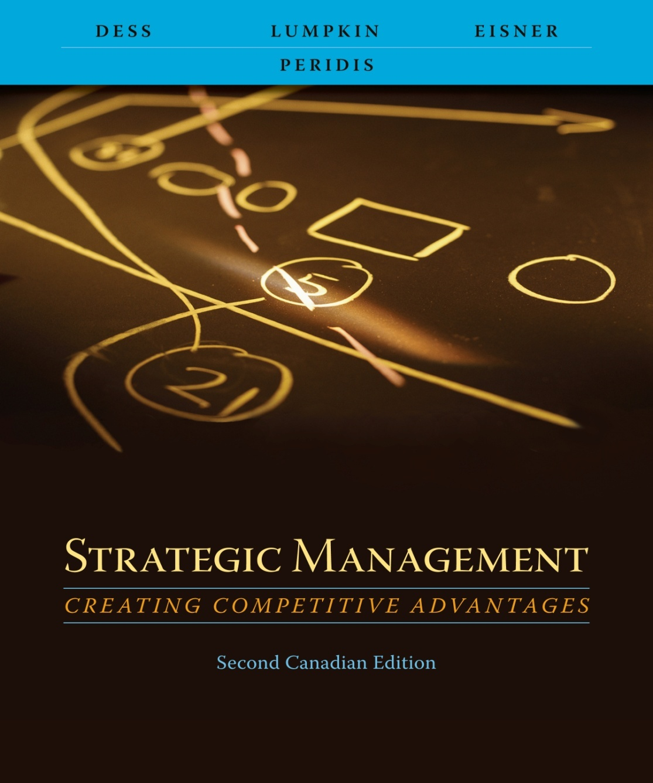
Chapter 3
Analyzing the Internal Environment of the Firm

Slide 2
Learning Objectives
After reading this chapter, you should have a good understanding of:
  How managers can use the value-chain analysis to gain insights into a firm’s internal environment
  How individual activities within the firm add value and how interrelationships among activities within the firm and between the firm and its suppliers and customers create value.
  How managers can use the resource-based view of the firm to gain insights into a firm’s internal environment.
  The four criteria that a firm’s resources must posses to maintain a sustainable advantage and how value created can be appropriated by employees.

Slide 3
Learning Objectives
After reading this chapter, you should have a good understanding of:
  How financial ratio analysis and other metrics of performance as well as meaningful comparisons across firms inform managers’ understanding of the workings of their own organization.
  The value of recognizing how the interests of a variety of stakeholders can be interrelated.

Slide 4
Value-Chain Analysis
Sequential process of value-creating activities
The amount that buyers are willing to pay for what a firm provides them
Value is measured by total revenue
Firm is profitable to the extent the value it receives exceeds the total costs involved in creating its product or service

Slide 5
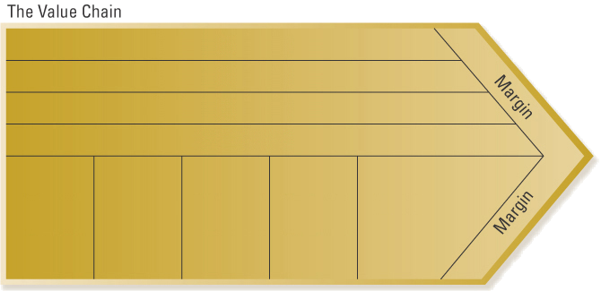

The Value Chain
General administration
Human resource management
Technology development
Procurement
Inbound logistics
Operations
Outbound logistics
Marketing and sales
Service
Adapted from Exhibit 3.1 The Value Chain: Primary and Support Activities
Source: Adapted with permission of The Free Press, a division of Simon & Schuster, Inc., from Competitive Advantage: Creating and Sustaining Superior Performance by Michael E. Porter.

Slide 6
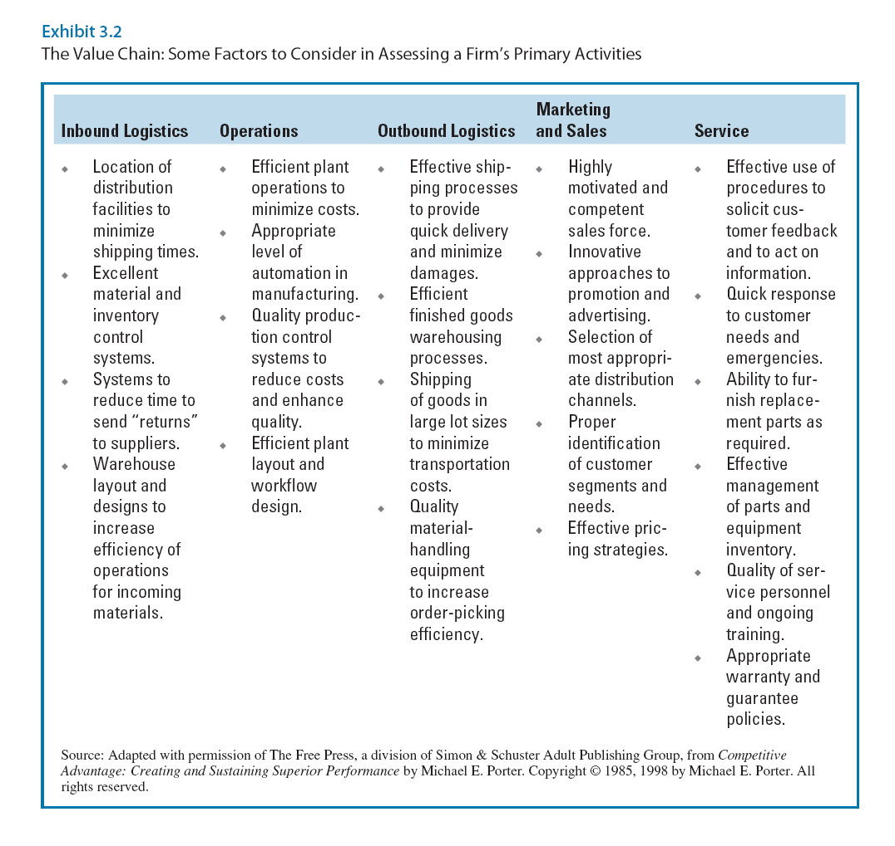

Slide 7
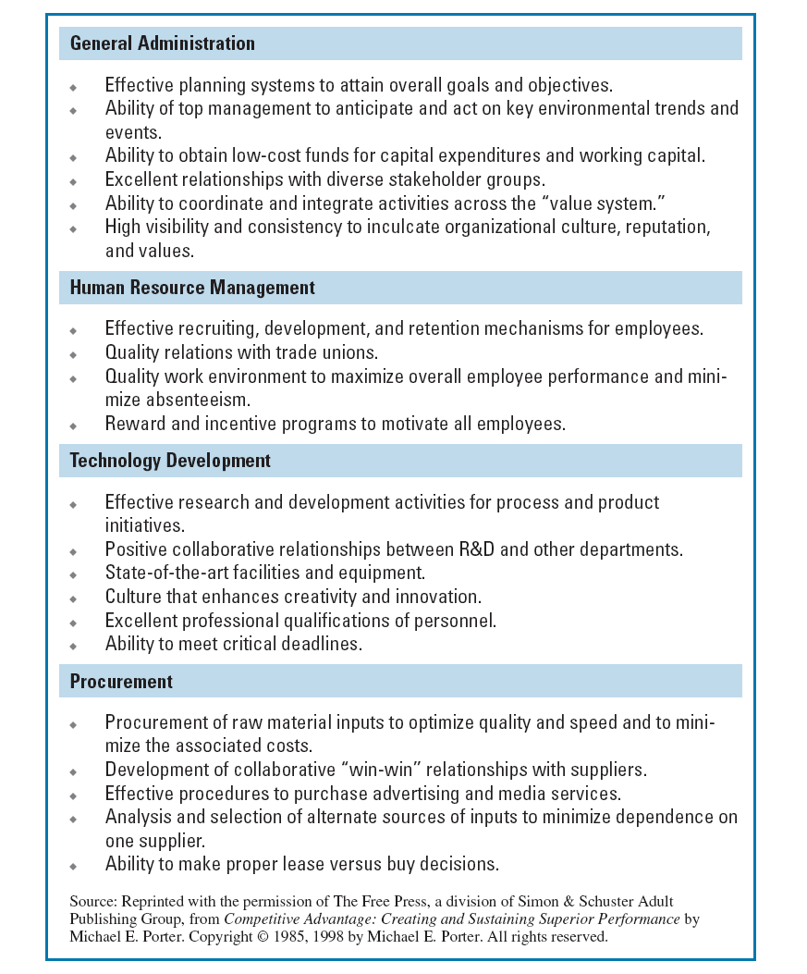

Slide 8
Interrelationships among Value-Chain Activities within and across Organizations
Importance of relationships among value activities
  Interrelationships among activities within the firm
  Relationships among activities within the firm and with other organizations (e.g., customers and suppliers)

Slide 9
Resource-Based View of the Firm
Two perspectives
  The internal analysis of phenomena within a company
  An external analysis of the industry and its competitive environment
Three key types of resources
  Intangible resources
  Tangible resources
  Organizational capabilities

Slide 10

Types of Resources
Relatively easy to identify, and include physical and financial assets used to create value for customers
  Financial resources
    Firm’s cash accounts
    Firm’s capacity to raise equity
    Firm’s borrowing capacity
  Physical resources
    Modern plant and facilities
    Favorable manufacturing locations
    State-of-the-art machinery and equipment
Adapted from Exhibit 3.4 The Resource-Based View of the Firm: Resources and Capabilities

Slide 11
Types of Resources
Relatively easy to identify, and include physical and financial assets used to create value for customers
  Technological resources
    Trade secrets
    Innovative production processes
    Patents, copyrights, trademarks
  Organizational resources
    Effective strategic planning processes
    Excellent evaluation and control systems
Adapted from Exhibit 3.4 The Resource-Based View of the Firm: Resources and Capabilities

Slide 12
Types of Resources
Intangible Resources
Difficult for competitors (and the firm itself) to account for or imitate, typically embedded in unique routines and practices that have evolved over time
  Human
    Experience and capabilities of employees
    Trust
    Managerial skills
    Firm-specific practices and procedures
Adapted from Exhibit 3.4 The Resource-Based View of the Firm: Resources and Capabilities

Slide 13
Types of Resources
Intangible Resources
  Difficult for competitors (and the firm itself) to account for or imitate, typically embedded in unique routines and practices that have evolved over time
  Innovation and creativity
    Technical and scientific skills
    Innovation capacities
  Reputation
  Effective strategic planning processes
  Excellent evaluation and control systems
Organizational Capabilities
Competencies or skills that a firm employs to transform inputs to outputs, and capacity to combine tangible and intangible resources to attain desired end
  Outstanding customer service
  Excellent product development capabilities
  Innovativeness of products and services
  Ability to hire, motivate, and retain human capital
Adapted from Exhibit 3.4 The Resource-Based View of the Firm: Resources and Capabilities

Slide 14
Types of Resources
Organizational Capabilities
Competencies or skills that a firm employs to transform inputs to outputs, and capacity to combine tangible and intangible resources to attain desired end
  Outstanding customer service
  Excellent product development capabilities
  Innovativeness of products and services
  Ability to hire, motivate, and retain human capital
Adapted from Exhibit 3.4 The Resource-Based View of the Firm: Resources and Capabilities

Slide 15
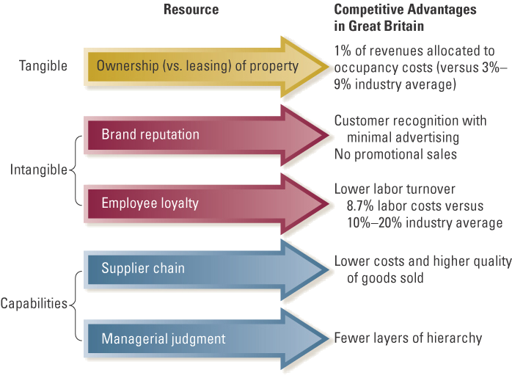
How Resources and Capabilities
Lead to Advantages
Adapted from Exhibit 3.5 Marks & Spencer: How Resources and Capabilities Lead to Advantages
Source: Adapted with permission of Harvard Business Review: Exhibit from
“Competing on Resources: Strategy in the 1990’s” by D. J. Collis and C. Montgomery, 73, no. 4 (1995).

Slide 16
Firm Resources and Sustainable Competitive Advantages
Is the resource or capability…
Valuable
Rare
Difficult to imitate
Exploitable
Implications
Contributes value to the customer
Neutralizes threats and exploits opportunities
Possessed by few competing firms
Difficult to substitute with other resources
Physical uniqueness
Path dependency
Causal ambiguity
Social complexity
Appropriate structures and systems
Adapted from Exhibit 3.6 Four Criteria for Assessing Sustainability of Resources and Capabilities
Copyright © 2009 The McGraw-Hill Ryerson Limited.

Slide 17
Is the Resource Valuable?
Organizational resources can be a source of competitive advantage only when they are valuable
  Enable a firm to formulate and implement strategies that improve its efficiency or effectiveness
  Resources are valuable when they are linked to the activities that are critically responsible to create what customers perceive as valuable

Slide 18
Is the Resource Rare?
Organizational resources also possessed by competitors are not sources of competitive advantage
  Common strategies based on similar resources give no one firm an advantage
  Competitive advantages are gained only from uncommon resources, resources that are rare to other competitors

Slide 19
Can the Resource Be Imitated?
Difficulty in imitating resources is key to value creation because it constrains competition
  Profits generated from inimitable resources are more likely to be sustainable
    Physical uniqueness
    Path dependency
    Causal ambiguity
    Social complexity

Slide 20
Are Substitutes Readily Available?
There must be no strategically equivalent valuable resources that are themselves not rare or inimitable
  Substitutability may take at least two forms
    Competitor may be able to substitute a similar resource that enables it to develop and implement the same strategy
    Very different firm resources can become strategic substitutes (such as e-business as a substitute for physical retail facility)

Slide 21
Criteria for Sustainable Competitive Advantage and Strategic Implications
Is a resource or capability…
Valuable Rare Difficult Exploitable Implications
to Imitate for Competitiveness
No No No No Competitive disadvantage
Yes No No No Competitive parity
Yes Yes No Yes Temporary competitive
advantage
Yes Yes Yes Yes Sustainable competitive
advantage
Exhibit 3.7 Criteria for Sustainable Competitive Advantage and Strategic Implications
Source; Adapted from J. Barney, “Gaining and Sustaining Competitive Advantage”, Addison-Wesley, 1997.
Copyright © 2009 The McGraw-Hill Ryerson Limited.

Slide 22
Evaluating Firm Performance
Two approaches for evaluating firm performance
  Financial ratio analysis
    Balance sheet
    Income statement
  Balanced scorecard (stakeholder perspective)
    Employees
    Customers
    Owners

Slide 23
Financial Ratio Analysis
Five types of financial ratios
  Short-term solvency or liquidity
  Long-term solvency measures
  Asset management (or turnover)
  Profitability
  Market value
Meaningful ratio analysis must include
  Analysis of how ratios change over time
  How ratios are interrelated

Slide 24
The Balanced Scorecard
Provides a meaningful integration of many issues that come into evaluating a firm’s performance
Four key perspectives
  How do customers see us? (customer perspective)
  What must we excel at? (internal perspective)
  Can we continue to improve and create value? (innovation and learning perspective)
  How do we look to shareholders? (financial perspective)

Slide 25


The Balanced Scorecard
Customer Perspective
Time
Quality
Performance and service
Cost
Processes
  Cycle time Quality
  Employee skills Productivity
Decisions
Actions
Coordination
Resources and capabilities
Internal Business
Perspective

Slide 26


The Balanced Scorecard
Introduction of new products and services
Greater value for customers
Increased operating efficiencies
Innovation and
Learning Perspective
Profitability
Growth
Shareholder value
Increased market share
Reduced operating expenses
Higher asset turnover
Financial Perspective

